Slide 1

Online Face Recognition Attendance System
1.Masrafi Al-Amin (221-15-5226)
2.Arefeen Ahammad (221-15-5080)
3.Md. Fardin Ahsan (221-15-5496)
4.Md. Misbah Uddin (221-15-5085)
5. Sanjida Akter Bably (221-15-5615)

Slide 2

Introduction
Facial recognition uses AI to identify individuals. Our project explores this technology, its functionalities.
Its potential applications in attendance, access control, and more.
Back to introduction

Slide 3

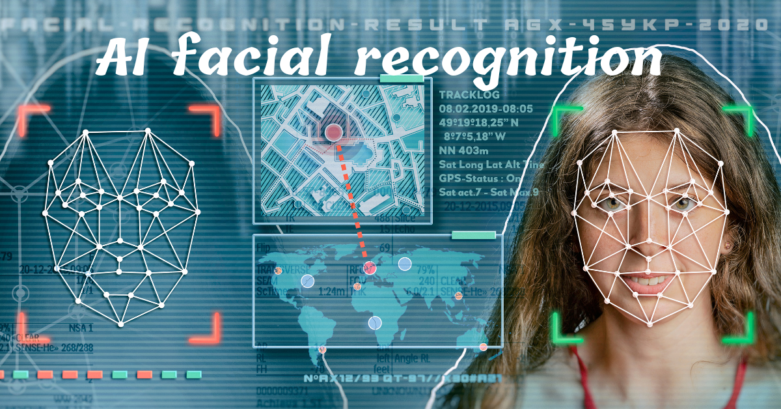

Project vision and mission
Saving time for teachers & giving digital service to all the students.
An automatic application to inter-connect all student informations
Task Timeline
Back to Agenda

Slide 4
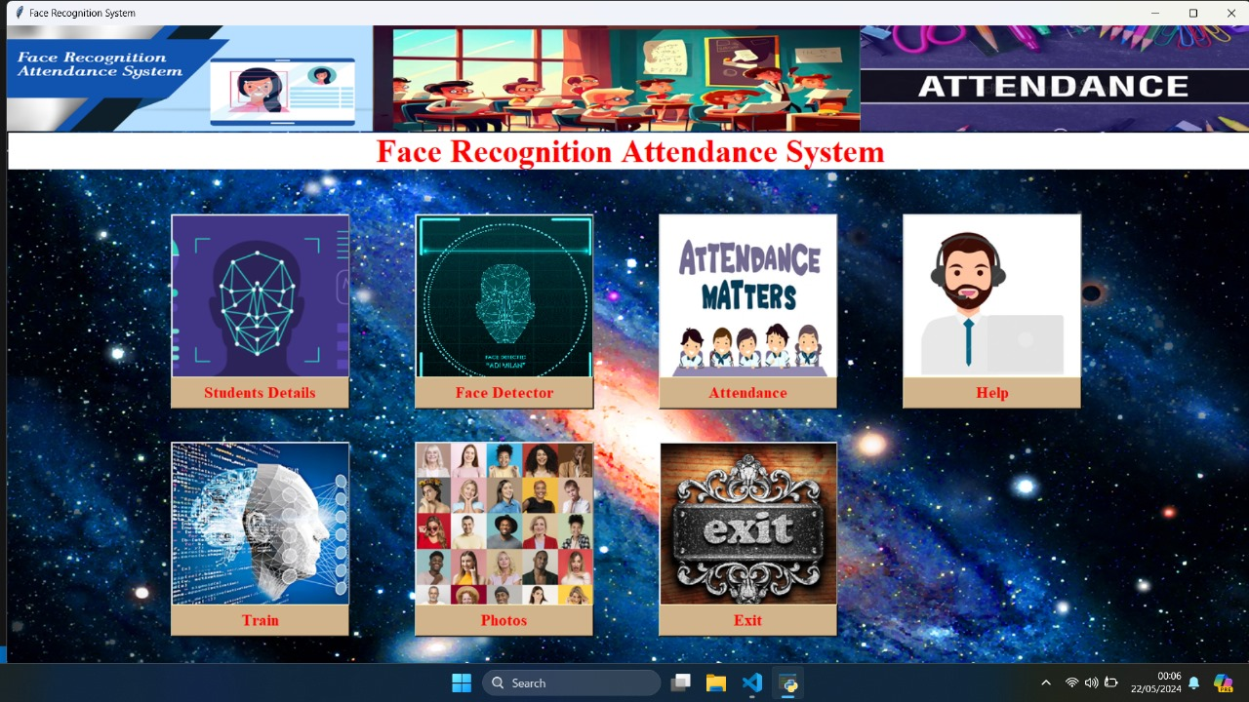
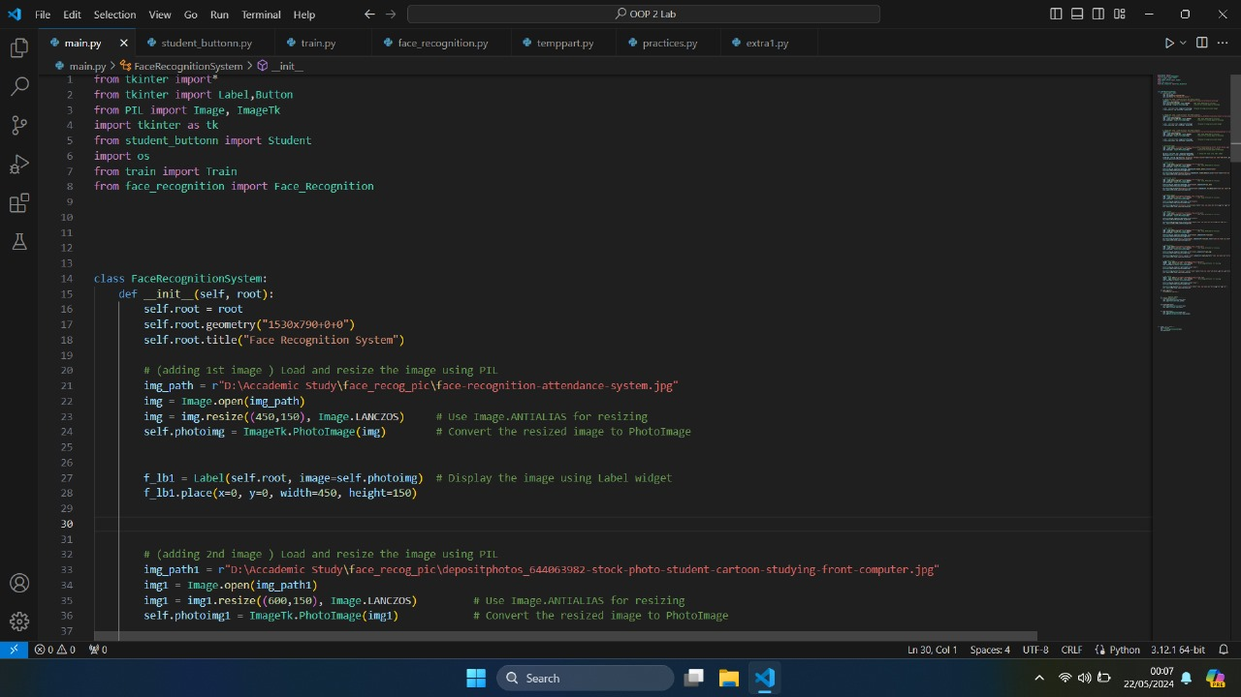
Home Page
Back to Agenda

Slide 5
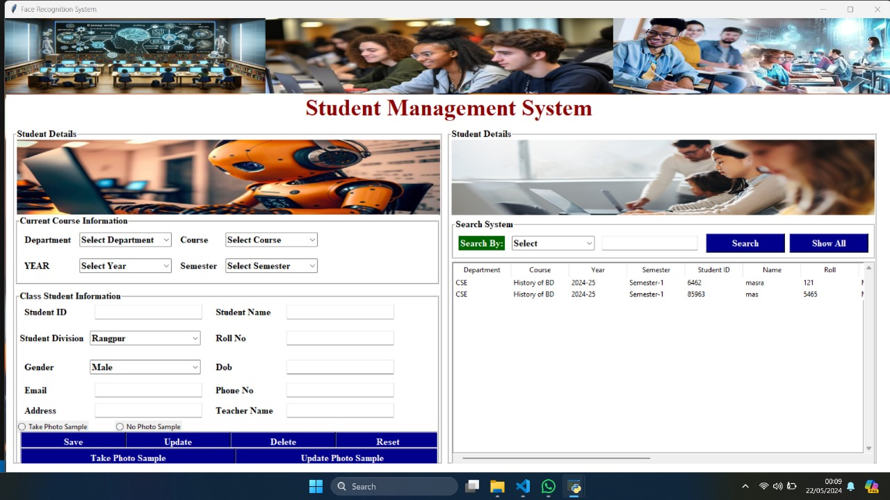
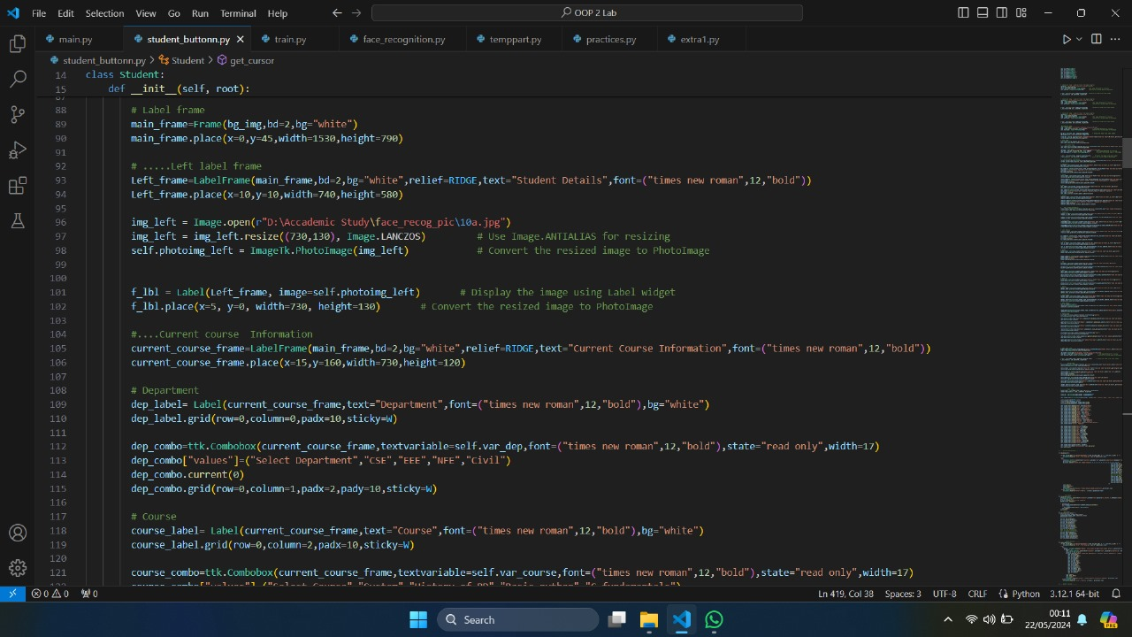
Student Details
Back to Agenda

Slide 6
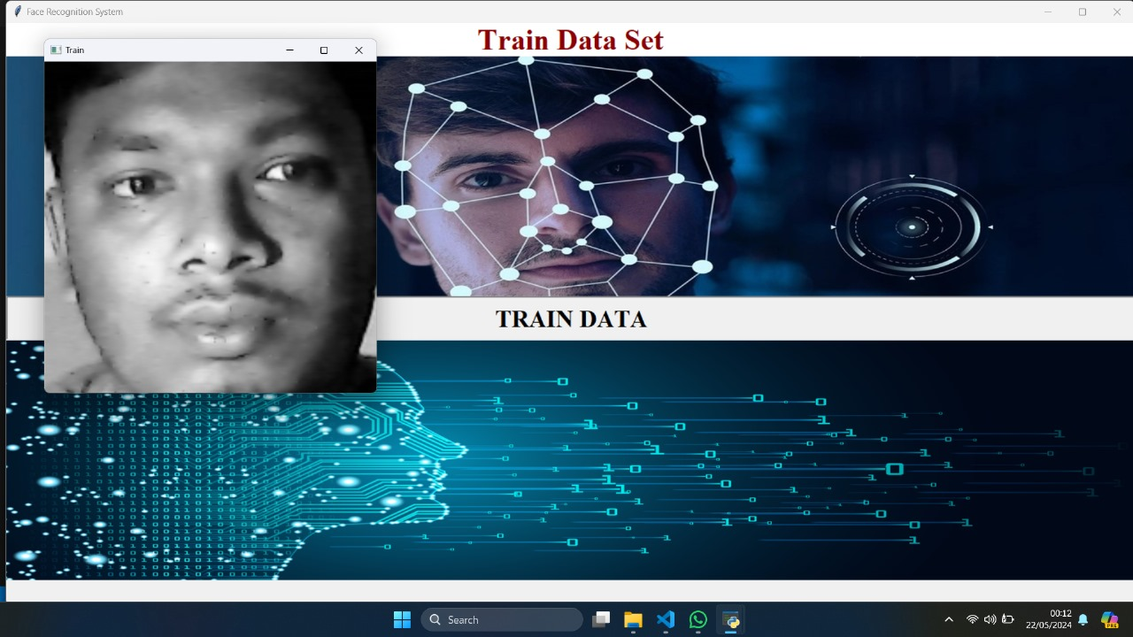
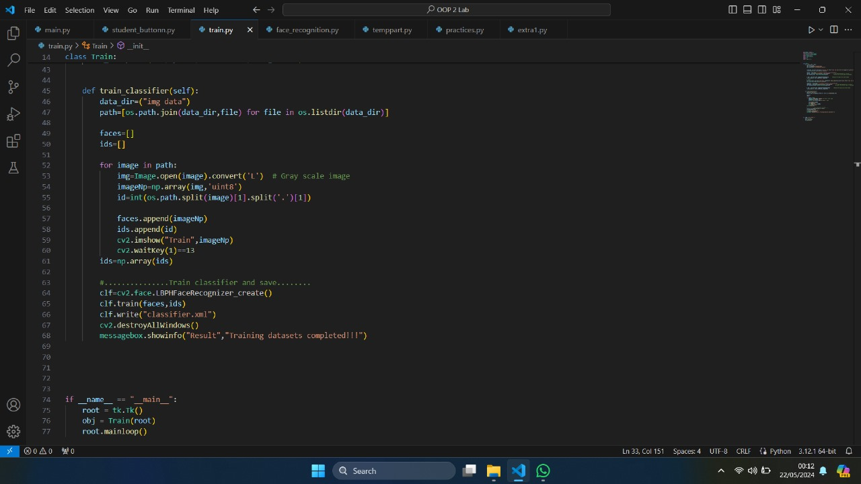
Train Data Set
Back to Agenda

Slide 7
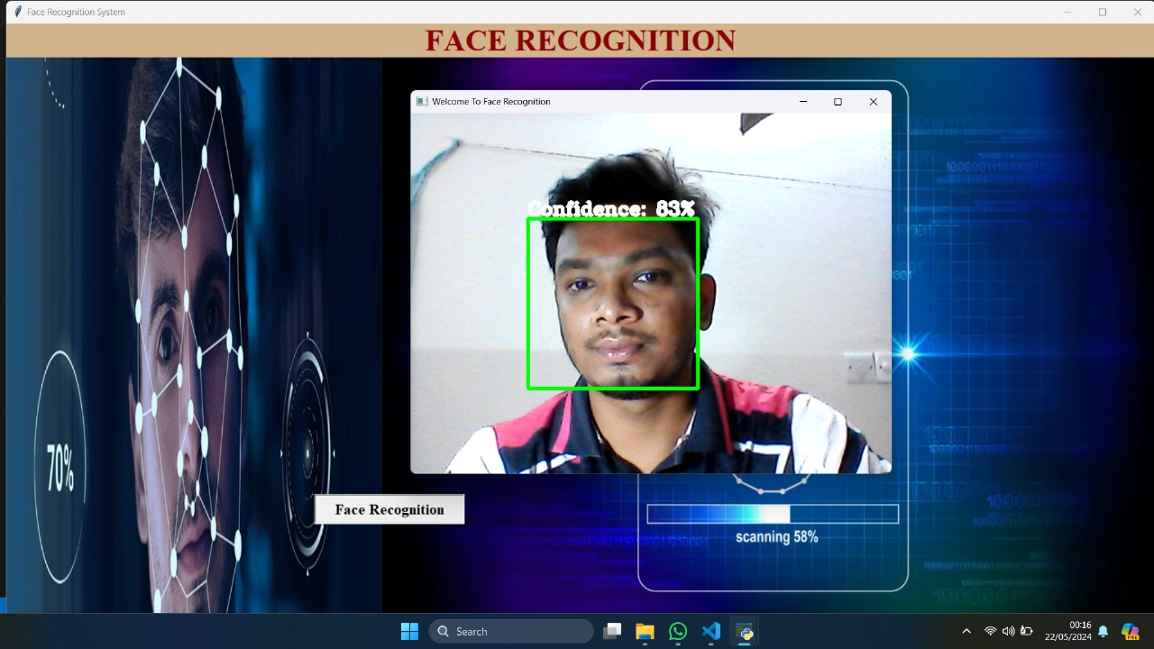
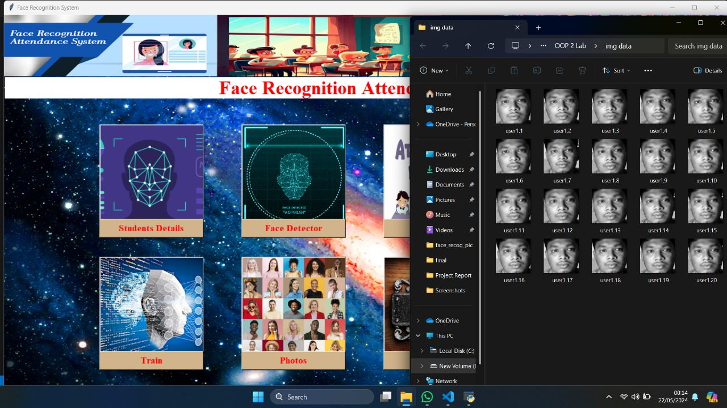
Face Detector
Back to Agenda

Slide 8

Future Possibilities
Impact on Academic Performance
Enhanced Learning Technology
Real-time processing with high Accuracy

Slide 9
Conclusion
This project has demonstrated the potential of AI-powered facial
The system achieved an accuracy rate in recognizing faces by its AI-powered face detector.
The limitations of your current prototype and future improvements you plan to make.
Invite feedback and suggestions for further refinement for our project
Back to Agenda

Slide 10

Back to Agenda

Slide 11

Any question?

